Slide 1
Overview
Simple linear regression is used to develop a model with just one independent variable. Limiting the number of independent variables to one may limit the usefulness of the model.
Multiple regression can be used to predict or explain the value of one dependent variable on the basis of two or more independent variables.
Multiple regression is used to develop a mathematical equation that describes the relationship among the variables.

Slide 2
Example
Based on Field (2009)
A record company executive wants to know if record sales can be predicted from any, or all, of a number of independent variables.
Data is available for 200 recently released records.
Y = Sales (in thousands) in the week after release.
X₁ = Advertising expenditure (in thousands of pounds) in the week prior to release.
X₂ = Number of times the record is played on Radio 1 during the week prior to release
X₃ = Attractiveness of the band (modal rating of attractiveness by sample taken from target population)
X₄ = Length of name of band (number of characters)

Slide 3
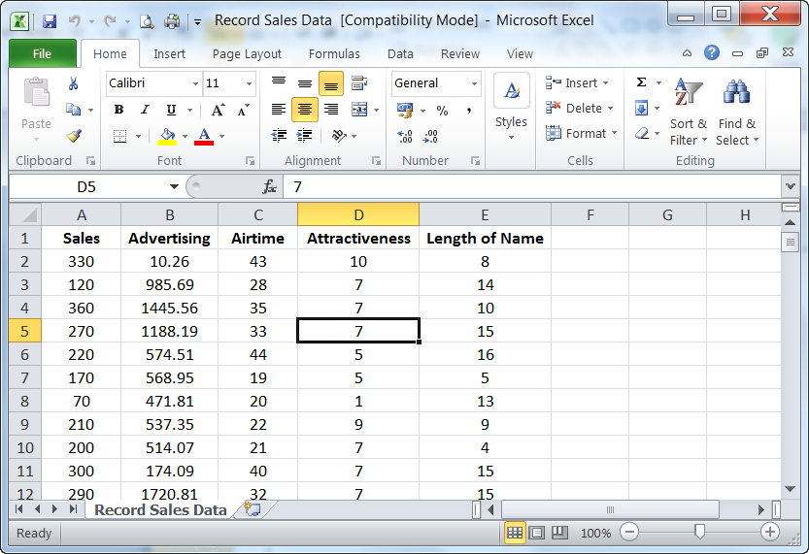
Data Input

Slide 4
Data Input
The data have been entered into Excel and saved as a file called “Record Sales Data”.
It should be possible to import the Excel file directly into R Studio. If not, save the file as a CSV (Comma Separated Values) file called (for example) “Record Sales Adverts.csv” and import that file.
> read.csv("Record Sales Data.csv") -> Record_Sales_Data
> attach(Record_Sales_Data)
…
> detach(Record_Sales_Data)

Slide 5
Data Input
> attach(Record_Sales_Data)
> Record_Sales_Data
Sales Advertising Airtime Attractiveness Length.of.Name
1 330 10.26 43 10 8
2 120 985.69 28 7 14
3 360 1445.56 35 7 10
4 270 1188.19 33 7 15
5 220 574.51 44 5 16
6 170 568.95 19 5 5
7 70 471.81 20 1 13
8 210 537.35 22 9 9
9 200 514.07 21 7 4
10 300 174.09 40 7 15
…
> detach(Record_Sales_Data)

Slide 6
Data Input
> summary(Record_Sales_Data)
Sales Advertising Airtime Attractiveness
Min. : 10.0 Min. : 9.1 Min. : 0.00 Min. : 1.00
1st Qu.:137.5 1st Qu.: 215.9 1st Qu.:19.75 1st Qu.: 6.00
Median :200.0 Median : 531.9 Median :28.00 Median : 7.00
Mean :193.2 Mean : 614.4 Mean :27.50 Mean : 6.77
3rd Qu.:250.0 3rd Qu.: 911.2 3rd Qu.:36.00 3rd Qu.: 8.00
Max. :360.0 Max. :2271.9 Max. :63.00 Max. :10.00
Length.of.Name
Min. : 3.000
1st Qu.: 8.000
Median : 9.000
Mean : 9.785
3rd Qu.:12.000
Max. :20.000

Slide 7
Requirements
To determine which, if any, of the four variables, (advertising expenditure, airtime, attractiveness and bandname) are related to record sales, and to determine the nature of such a relationship.

Slide 8
Intuitive Analysis
Before embarking on a more elaborate analysis, the correlations between the dependent variable (record sales) and the independent variables (the other four variables) can be examined:
Advertising expenditure has a correlation of 0.578 with record sales (p < 0.001).
Airtime has a correlation of 0.599 with record sales (p < 0.001).
Attractiveness has a correlation of 0.326 with record sales (p < 0.001).
Bandname has a correlation of 0.007 with record sales (p = 0.918).

Slide 9
Correlations in R
> cor(Record_Sales_Data)
Sales Advertising Airtime Attractiveness Length.of.Name
Sales 1.000000000 0.578487839 0.59891880 0.32611105 0.007357062
Advertising 0.578487839 1.000000000 0.10188328 0.08075153 -0.007309456
Airtime 0.598918798 0.101883283 1.00000000 0.18198863 0.036016749
Attractiveness 0.326111052 0.080751530 0.18198863 1.00000000 0.073673504
Length.of.Name 0.007357062 -0.007309456 0.03601675 0.07367350 1.000000000
> cor.test(Sales,Advertising)
Pearson's product-moment correlation
data: Sales and Advertising
t = 9.9793, df = 198, p-value < 2.2e-16
alternative hypothesis: true correlation is not equal to 0
95 percent confidence interval:
0.4781208 0.6639410
sample estimates:
cor
0.5784878
> plot(Record_Sales_Data)

Slide 10
Correlation Matrix in R

Slide 11
Intuitive Analysis (cont.)
We thus expect airtime to have the strongest relationship with record sales.
But is this correlation strong enough to be a real relationship in conjunction with the other independent variables?
Do the other variables have correlations so low that they are not going to have a real relationship?

Slide 12
Multiple Regression
A multiple regression can be carried out which relates all four independent variables to the dependent variable, using an extension of the simple linear regression equation:
Y = β₀ + β₁X₁ + β₂X₂ + β₃X₃+ β₄X₄

Slide 13
Multiple Regression in R
> lm(Sales~Advertising+Airtime+Attractiveness+Length.of.Name)
Call:
lm(formula = Sales ~ Advertising + Airtime + Attractiveness +
Length.of.Name)
Coefficients:
(Intercept) Advertising Airtime Attractiveness Length.of.Name
-22.07101 0.08483 3.37095 11.17433 -0.53145

Slide 14
Multiple Regression in R (cont.)
> summary(lm(Sales~Advertising+Airtime+Attractiveness+Length.of.Name))
Call:
lm(formula = Sales ~ Advertising + Airtime + Attractiveness +
Length.of.Name)
Residuals:
Min 1Q Median 3Q Max
-120.378 -28.846 -0.183 28.682 144.061
Coefficients:
Estimate Std. Error t value Pr(>|t|)
(Intercept) -22.071014 19.455498 -1.134 0.258
Advertising 0.084829 0.006937 12.229 < 2e-16 ***
Airtime 3.370945 0.278372 12.109 < 2e-16 ***
Attractiveness 11.174327 2.448262 4.564 8.86e-06 ***
Length.of.Name -0.531449 1.022536 -0.520 0.604
---
Signif. codes: 0 ‘***’ 0.001 ‘**’ 0.01 ‘*’ 0.05 ‘.’ 0.1 ‘ ’ 1
Residual standard error: 47.18 on 195 degrees of freedom
Multiple R-squared: 0.6651, Adjusted R-squared: 0.6583
F-statistic: 96.83 on 4 and 195 DF, p-value: < 2.2e-16

Slide 15
Multiple Regression (cont.)
We obtain β₀ = −22.071, β_{advertising} = 0.085,
β_{airtime} = 3.371, β_{attractiveness} = 11.174, β_{bandname} = − 0.531
Regression equation:
sales = −22.071 + (0.085)(advertising) + (3.371)(airtime) + (11.174)(attractiveness) – (0.531)(bandname)
Note:
Just because β_{advertising} is nearer to zero than the other coefficients, it does not necessarily mean that it is the least important. The coefficients must be multiplied by the variables themselves and, in this case, advertising budget values are large compared to the raw data values for airtime and attractiveness.

Slide 16
Multiple Regression (cont.)
If there were no real linear relationship between the four independent variables and the dependent (Y) variable, then the coefficient of each of the independent variables would be zero.
Thus, if we want to test whether or not this regression line is showing a significant relationship between the dependent variable and the independent variables, we can test the following hypotheses:
H₀: β₁ = β₂ = β₃ = β₄ = 0
H₁: At least one of β₁, β₂, β₃ , β₄ ≠ 0

Slide 17
Multiple Regression (cont.)
This can be done through the F-statistic in the bottom line of the output, which has a p-value of p < 0.001.
We therefore reject H₀ at the 5% level of significance and conclude that the fitted regression line is significant (i.e. at least one of the independent variables has a non-zero coefficient).

Slide 18
Multiple Regression (cont.)
We can also test each of the coefficients individually, albeit in the presence of the other independent variables, using a t-test for the hypotheses:
H₀: β_{k} = 0
H₁: β_{k} ≠ 0
The intercept is not significantly different from zero (p = 0.258), and the coefficient of bandname is not significantly different from zero (p = 0.604) but the coefficients of the other three independent variables are significantly different from zero (p < 0.001 in every case).

Slide 19
Multiple Regression (cont.)
From the (Multiple) R² value, we can also get a measure of how well the straight line fits the data (how strong a linear relationship exists).
As with simple linear regression, the R² value ranges from 0 (0%) to 1 (100%).
If R² is over 90% then the fit of the straight line to the data is remarkably good. If it is between 80% and 90% then it is a good fit. 60% to 80% indicates a reasonable fit and below 60% the fit is not too good.

Slide 20
Multiple Regression (cont.)
(Multiple) R² = 0.665 or 66.5%.
This means that two thirds of the variability in record sales in the sample can be explained by the regression equation involving the four independent variables.
Adjusted R² = 0.658 or 65.8%.
This means that two thirds of the variability in record sales in the population can be explained by the regression equation involving the four independent variables.

Slide 21
Assumptions
For the hypothesis tests from the ANOVA or t-tests of coefficients in regression, we must assume that the errors/residuals are Normally distributed with constant variance and that they are independent of each other.
We are also assuming that a linear relationship potentially exists.

Slide 22
MODEL SELECTION

Slide 23
Model Selection Methods
If using a small number of independent variables produces a model that fits the data only marginally worse than a model having a larger number, then we would prefer the smaller model as it gives a more parsimonious description of the data.
We may seek to remove those variables from the model that have little effect. However, we cannot simply remove those variables which have non-significant coefficients as removing one variable will affect the coefficients of the others.
Alternatively, may seek to include only those variables that have an effect. Again, adding a variable will affect the coefficients of the others.

Slide 24
Model Selection Methods
There are three commonly employed methods for variable selection:
Forward selection
Backward elimination
Stepwise
Although these methods have similar goals, they will not always result in the same final model!

Slide 25
Forward Selection
Begin with no independent variables in the model and add variables one at a time until there is no significant improvement in the model.

Slide 26
Backward Elimination
Begin with all independent variables in the model and remove variables one at a time until there is a marked deterioration in the model.

Slide 27
Stepwise
A combination of forward selection and backward elimination.
Begin as in forward selection, but each time a variable is added to the model, test the variables already in the model to see if any are no longer significant and can now be removed.

Slide 28
Model Selection in R
Full model (all independent variables):
> full=lm(Sales~Advertising+Airtime+Attractiveness+Length.of.Name)
> summary(full)
Call:
lm(formula = Sales ~ Advertising + Airtime + Attractiveness +
Length.of.Name)
Residuals:
Min 1Q Median 3Q Max
-120.378 -28.846 -0.183 28.682 144.061
Coefficients:
Estimate Std. Error t value Pr(>|t|)
(Intercept) -22.071014 19.455498 -1.134 0.258
Advertising 0.084829 0.006937 12.229 < 2e-16 ***
Airtime 3.370945 0.278372 12.109 < 2e-16 ***
Attractiveness 11.174327 2.448262 4.564 8.86e-06 ***
Length.of.Name -0.531449 1.022536 -0.520 0.604
---
Signif. codes: 0 ‘***’ 0.001 ‘**’ 0.01 ‘*’ 0.05 ‘.’ 0.1 ‘ ’ 1
Residual standard error: 47.18 on 195 degrees of freedom
Multiple R-squared: 0.6651, Adjusted R-squared: 0.6583
F-statistic: 96.83 on 4 and 195 DF, p-value: < 2.2e-16

Slide 29
Model Selection in R
Null model (no independent variables):
> null=lm(Sales~1)
> summary(null)
Call:
lm(formula = Sales ~ 1)
Residuals:
Min 1Q Median 3Q Max
-183.2 -55.7 6.8 56.8 166.8
Coefficients:
Estimate Std. Error t value Pr(>|t|)
(Intercept) 193.200 5.706 33.86 <2e-16 ***
---
Signif. codes: 0 ‘***’ 0.001 ‘**’ 0.01 ‘*’ 0.05 ‘.’ 0.1 ‘ ’ 1
Residual standard error: 80.7 on 199 degrees of freedom

Slide 30
Model Selection in R: Forward Selection
> step(null, scope=list(upper=full, lower=null), direction="forward", trace=FALSE)
Call:
lm(formula = Sales ~ Airtime + Advertising + Attractiveness)
Coefficients:
(Intercept) Airtime Advertising Attractiveness
-26.61294 3.36742 0.08488 11.08634

Slide 31
Model Selection in R: Backward Elimination
> step(full, scope=list(upper=full, lower=null),
direction="backward", trace=FALSE)
Call:
lm(formula = Sales ~ Advertising + Airtime + Attractiveness)
Coefficients:
(Intercept) Advertising Airtime Attractiveness
-26.61294 0.08488 3.36742 11.08634

Slide 32
Model Selection in R: Stepwise Regression
> step(null, scope=list(upper=full, lower=null),
direction="both", trace=FALSE)
Call:
lm(formula = Sales ~ Airtime + Advertising + Attractiveness)
Coefficients:
(Intercept) Airtime Advertising Attractiveness
-26.61294 3.36742 0.08488 11.08634

Slide 33
Results/Conclusions
Using stepwise regression it would appear that three out of the four independent variables are needed to explain record sales.
For this example, all three model selection methods give the same result.
Providing the assumptions are justified, the resultant regression equation can now be used to make predictions and/or marketing adjustments.

Slide 34
Final Model in R
> final.model=lm(Sales~Advertising+Airtime+Attractiveness)
> final.model
Call:
lm(formula = Sales ~ Advertising + Airtime + Attractiveness)
Coefficients:
(Intercept) Advertising Airtime Attractiveness
-26.61294 0.08488 3.36742 11.08634

Slide 35
Final Model in R
> final.model=lm(Sales~Advertising+Airtime+Attractiveness)
> summary(final.model)
Call:
lm(formula = Sales ~ Advertising + Airtime + Attractiveness)
Residuals:
Min 1Q Median 3Q Max
-121.324 -28.335 -0.451 28.967 144.132
Coefficients:
Estimate Std. Error t value Pr(>|t|)
(Intercept) -26.612942 17.350004 -1.534 0.127
Advertising 0.084885 0.006923 12.261 < 2e-16 ***
Airtime 3.367424 0.277771 12.123 < 2e-16 ***
Attractiveness 11.086338 2.437850 4.548 9.49e-06 ***
---
Signif. codes: 0 ‘***’ 0.001 ‘**’ 0.01 ‘*’ 0.05 ‘.’ 0.1 ‘ ’ 1
Residual standard error: 47.09 on 196 degrees of freedom
Multiple R-squared: 0.6647, Adjusted R-squared: 0.6595
F-statistic: 129.5 on 3 and 196 DF, p-value: < 2.2e-16

Slide 36
Prediction
By hand:
Sales = −26.613 + (0.085 )(Advertising) + (3.367)(Airtime) + (11.086)(Attractiveness)
Sales = −26.613 + (0.085 )(600) + (3.367)(27.5) + (11.086)(7)
Sales = 194.5815
In R:
> predict(final.model, list(Advertising=600,Airtime=27.5,
Attractiveness=7,Length.of.Name=10))
1
194.5264

Slide 37
MODEL CHECKING

Slide 38
Examining the Residuals
Remember that the fitted regression line is such that the sum of the squared residuals (errors) is a minimum. The residuals are also of interest for other reasons.
By considering the values of the residuals for the fitted regression line, we can identify outliers and patterns in the data which we may not have noticed from an initial examination of the data.
Assumptions concerning the residuals:
Normally distributed with mean 0.
Constant variance (homoscedasticity)

Slide 39
Residual Plots in R
> par(mfrow=c(2,2)) #optional
> plot(final.model)

Slide 40
Residual Plots in R

Slide 41
How to Deal With Outliers?
May consider removing the offending observation(s) and recomputing the regression equation.

Slide 42
Example of Heteroscedasticity

Slide 43
How to Deal With Heteroscedasticity?
May need to transform the Y values.

Slide 44
Example of Non-Linearity

Slide 45
How to deal with a Non-Linear Relationship between X and Y?
May be able to transform the X and/or Y values to give a straight line.
May need to fit a curve (called “polynomial regression”).

Slide 46
CATEGORICAL VARIABLES

Slide 47
Variables in Regression
In multiple regression the dependent variable is always quantitative.
In the Record Sales example, all of the independent variables are quantitative (true numerical values).
It is possible to incorporate categorical (qualitative) independent variables in multiple regression.

Slide 48
Example (Extended)
Based on Field (2009)
A record company executive wants to know if record sales can be predicted from any, or all, of a number of independent variables.
Data is available for 200 recently released records.
Y = Sales (in thousands) in the week after release.
X₁ = Advertising expenditure (in thousands of pounds) in the week prior to release.
X₂ = Number of times the record is played on Radio 1 during the week prior to release
X₃ = Attractiveness of the band (modal rating of attractiveness by sample taken from target population)
X₄ = Length of name of band (number of characters)
X₅ = Genre (Country, Hip Hop, Jazz, Pop, R&B, Rock, Soul) NEW!!!

Slide 49
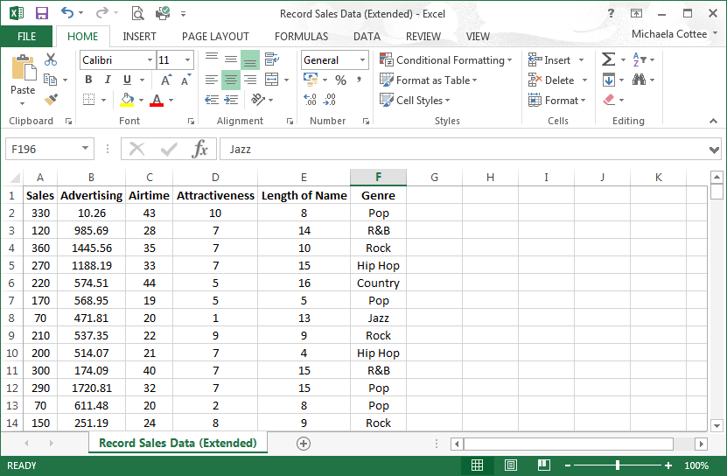
Data Input

Slide 50
Data Input
The data have been entered into Excel and saved as a file called “Record Sales Data (Extended)”
It should be possible to import the Excel file directly into R Studio. If not, save the file as a CSV (Comma Separated Values) file called (for example) “Record Sales Adverts.csv” and import that file.
> read.csv("Record Sales Data (Extended).csv") -> Record_Sales_Data_Ext
> attach(Record_Sales_Data.ext)
…
> detach(Record_Sales_Data_Ext)

Slide 51
Data Input
> attach(Record_Sales_Data_Ext)
> Record_Sales_Data_Ext
Sales Advertising Airtime Attractiveness Length.of.Name Genre
1 330 10.26 43 10 8 Pop
2 120 985.69 28 7 14 R&B
3 360 1445.56 35 7 10 Rock
4 270 1188.19 33 7 15 Hip Hop
5 220 574.51 44 5 16 Country
6 170 568.95 19 5 5 Pop
7 70 471.81 20 1 13 Jazz
8 210 537.35 22 9 9 Rock
9 200 514.07 21 7 4 Hip Hop
10 300 174.09 40 7 15 R&B
…
> detach(Record_Sales_Data_Ext)

Slide 52
Quantitative Variables…
> lm(Sales~Advertising+Airtime)
Call:
lm(formula = Sales ~ Advertising + Airtime)
Coefficients:
(Intercept) Advertising Airtime
41.12384 0.08689 3.58879
N.B. I chose to use these two quantitative variables for illustrative purposes only.

Slide 53
Categorical (Text) Variable…
> lm(Sales~Advertising+Airtime+Genre)
Call:
lm(formula = Sales ~ Advertising + Airtime + Genre)
Coefficients:
(Intercept) Advertising Airtime GenreHip Hop GenreJazz
48.62438 0.08606 3.54201 -11.83786 -3.56616
GenrePop GenreR&B GenreRock GenreSoul
-10.02813 -9.09157 -2.07784 2.77054

Slide 54
Categorical (Numerical) Variable…
> lm(Sales~Advertising+Airtime+factor(Attractiveness))
Call:
lm(formula = Sales ~ Advertising + Airtime + factor(Attractiveness))
Coefficients:
(Intercept) Advertising Airtime
-25.93832 0.08481 3.28404
factor(Attractiveness)2 factor(Attractiveness)3 factor(Attractiveness)4
-21.60503 -16.68446 59.53336
factor(Attractiveness)5 factor(Attractiveness)6 factor(Attractiveness)7
59.99209 64.83265 89.52006
factor(Attractiveness)8 factor(Attractiveness)9 factor(Attractiveness)10
78.06840 90.58450 213.85444
N.B. Until now I have been treating “Attractiveness” as a quantitative variable but, being rating scale data, this may not be appropriate. Hence I am treating it as a categorical variable here.

